Slide 1
Final Presentation – Interview Question
Lloyd Armor

Slide 2
Interview Question
What is difference between comparison and non-comparison-based sorting algorithms?
Companies: Amazon, Microsoft, Netflix, Airbnb
Found: Commonly Asked Sorting Algorithm Interview Questions from geeksforgeeks; Sorting Algorithms Interview Questions from devinterview
Addresses: Sorting Algorithms

Slide 3
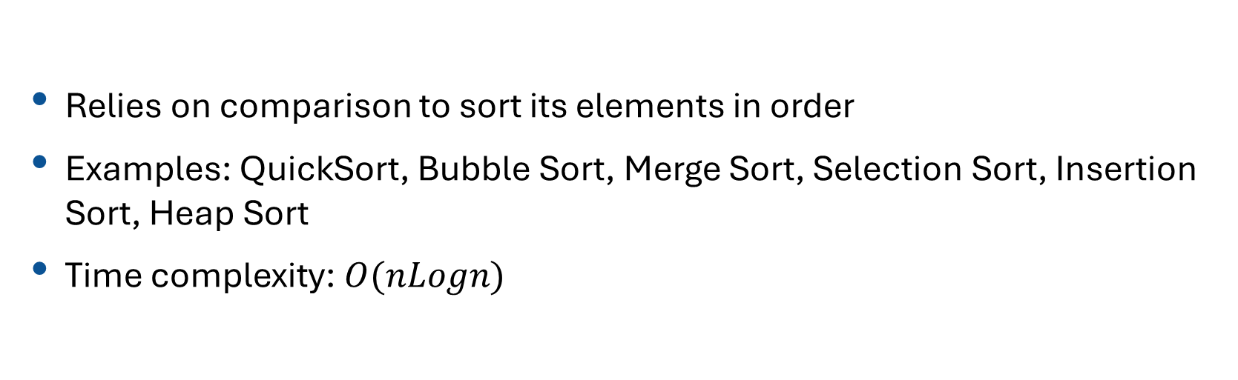
Comparison Based Algorithms
Relies on comparison to sort its elements in order
Examples: QuickSort, Bubble Sort, Merge Sort, Selection Sort, Insertion Sort, Heap Sort
Time complexity: $O(nLogn)$

Slide 4
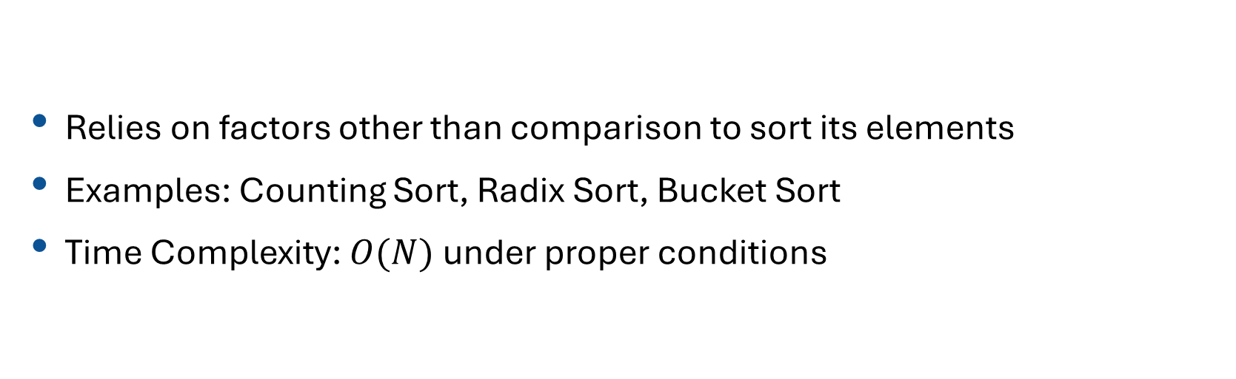
Non-Comparison Sorting Algorithms
Relies on factors other than comparison to sort its elements
Examples: Counting Sort, Radix Sort, Bucket Sort
Time Complexity: $O(N)$under proper conditions

Slide 5
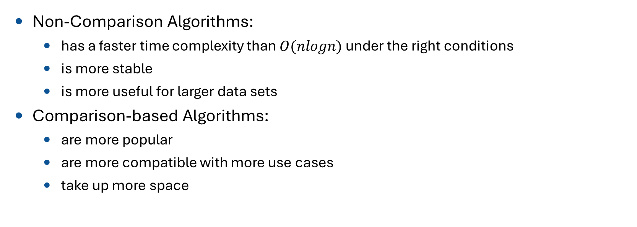
Differences
Non-Comparison Algorithms:
  has a faster time complexity than $O(nlogn)$under the right conditions
  is more stable
  is more useful for larger data sets
Comparison-based Algorithms:
  are more popular
  are more compatible with more use cases
  take up more space

Slide 6
Non-Comparison Limitations
Radix Sort: The elements need to either be integers or strings with fixed sizes. It is most effective if the element with the maximum integer is located at the end of the array from the start.
Counting Sort: the elements have to be integers. The range of integers also shouldn't be larger than the size of the array.
Bucket Sort: Best effective when the elements of the array can be distributed into buckets neatly. It can be considered comparison based

Slide 7
Code Example Notes

Slide 8
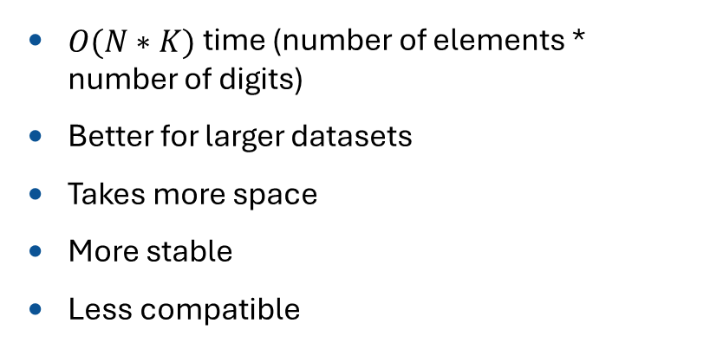
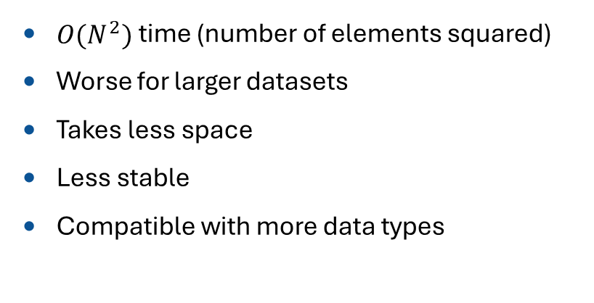
Conclusion
Selection Sort
Radix Sort
$O(N^{2})$time (number of elements squared)
Worse for larger datasets
Takes less space
Less stable
Compatible with more data types
$O(N∗K)$time (number of elements * number of digits)
Better for larger datasets
Takes more space
More stable
Less compatible

Slide 9
References
“Commonly Asked Algorithm Interview Questions.” GeeksforGeeks, GeeksforGeeks, 3 Sept. 2025, www.geeksforgeeks.org/dsa/commonly-asked-algorithm-interview-questions-set-1/.
Devinterview-io. “Sorting Algorithms Interview Questions and Answers to Help You Prepare for Your next Data Structures and Algorithms Interview in 2025.” GitHub, github.com/Devinterview-io/sorting-algorithms-interview-questions. Accessed 30 Nov. 2025.
“Analysis of Different Sorting Techniques.” GeeksforGeeks, GeeksforGeeks, 28 July 2025, www.geeksforgeeks.org/dsa/analysis-of-different-sorting-techniques/.
“Sorting Interview Questions & Tips for Senior Engineers.” For Senior Engineers, interviewing.io/sorting-interview-questions. Accessed 30 Nov. 2025.
SonalRoche. “Comparing Popular Sorting Algorithms: A Practical Overview.” Medium, medium.com/@sonal98roche/comparing-popular-sorting-algorithms-a-practical-overview-f7e41ecbd1e3. Accessed 30 Nov. 2025.
GeeksforGeeks. “Counting Sort.” GeeksforGeeks, 29 Sept. 2025, www.geeksforgeeks.org/dsa/counting-sort/.
“Applications, Advantages and Disadvantages of Radix Sort.” GeeksforGeeks, GeeksforGeeks, 23 July 2025, www.geeksforgeeks.org/dsa/applications-advantages-and-disadvantages-of-radix-sort/.
GeeksforGeeks. “Selection Sort.” GeeksforGeeks, 23 July 2025, www.geeksforgeeks.org/dsa/selection-sort-algorithm-2/.

